Slide 1
GALATIANS

Slide 2
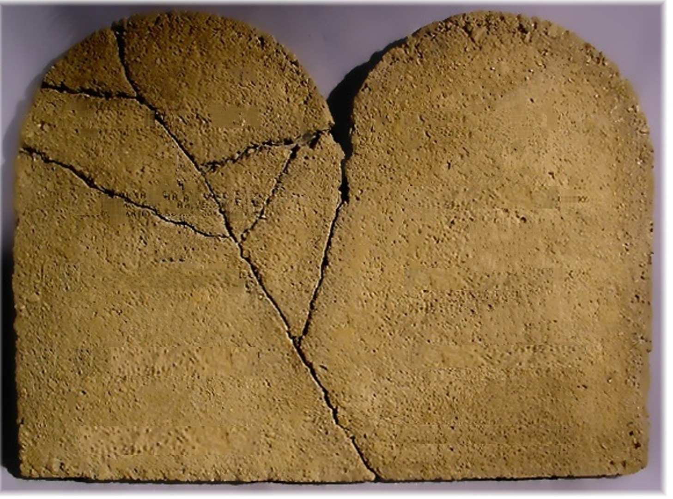
GALATIANS
It is a misdemeanor to shoot at any kind of game from a moving vehicle, unless the target is a whale.
No vehicle without a driver may exceed 60 miles per hour
California

Slide 3
GALATIANS
Churches, hotels, halls of assembly, stores, markets, banking rooms, railroad depots, and saloons must provide spittoons “of a kind and number to efficiently contain expectorations into them."
criminals Must give their victims 24 hours notice, either orally or in writing, and explain the nature of the crime to be committed.
Obnoxious odors may not be emitted while in an elevator.
Port Arthur
El Paso
Texas

Slide 4
GALATIANS
Citizens may not greet each other by “putting one's thumb to the nose and wiggling the fingers"
The penalty for jumping off a building is death
New York City
New York

Slide 5
GALATIANS
You may not carry a concealed weapon that is over six feet in length
It is illegal to pretend that one's parents are rich
Seattle
Washington

Slide 6
GALATIANS
It is illegal to have the hind legs of farm animals in your boots.
Violators can be fined, arrested or jailed for making ugly faces at a dog
Whaling is illegal
Note: while in Ohio, it’s only banned on Sundays
Oklahoma

Slide 7
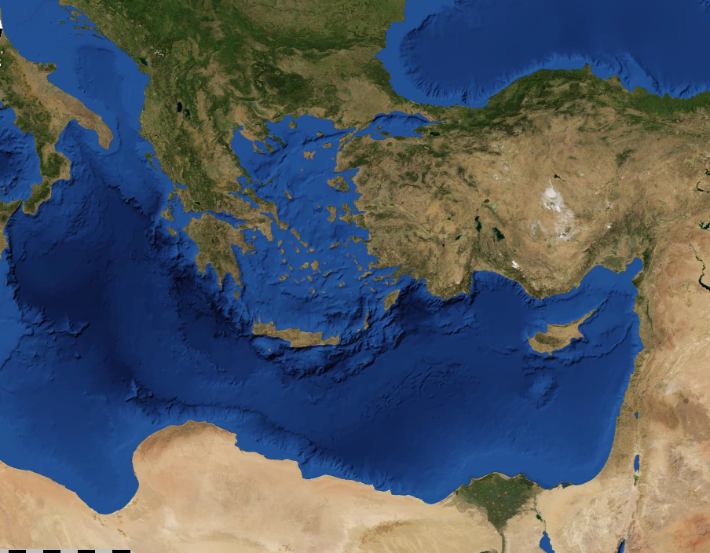
GALATIANS
Galatia

Slide 8
GALATIANS
The just
shall live
by faith
Rom. 1.17
Gal. 3.11
Heb. 10.38
Habakkuk 2.4

Slide 9
GALATIANS
Different (v. 6) ~ heteros (another of a different kind)
Another (v. 7) ~ allos (another of the same kind)

Slide 10
GALATIANS
¹⁸ But someone will say, "You have faith, and I have works." Show me your faith without your works, and I will show you my faith by my works. ¹⁹ You believe that there is one
God. You do well. Even the
demons believe—and tremble!
²⁰ But do you want to know, O
foolish man, that faith without
works is dead? ²¹ Was not
Abraham our father justified
by works when he offered
Isaac his son on the altar? ²² Do you see that faith was working together with his works, and by works faith was made perfect? ²³ And the Scripture was fulfilled which says,
"Abraham believed God, and it
was accounted to him for righteousness." And he was
called the friend of God.
James 2.18-23

Slide 11
GALATIANS
Tutor ~ paidagōgos – pedagogue

Slide 12
GALATIANS
Symbolic ~ allēgorerō – allegory

Slide 13
GALATIANS
Estranged ~ apo – away from + katargeō – destroyed
NASB ~ severed

